Slide 1
“Emergency alert and tracking device for women safety”
Mini Project – III
By:
M SUCHITH 1NH18EC063
RAMYA PRIYA Y 1NH18EC095
TANMAYA H 1NH18EC112
Guided By
Dr. K C R Nisha
Professor
Dept. of ECE
New Horizon College of Engineering, Bengaluru.

Slide 2
Contents
Introduction
Literature Review
Existing System
Problem Statement & Objectives
Proposed System
Block Diagram
Hardware & Software Specification
Circuit Diagram & Working
Flow Chart
Results & Discussion
Advantages
Conclusion & Future Scope
References
Progress Work
Milestones/Schedule

Slide 3
Introduction
Even in this era women are feeling insecure to step out house because of increase in crimes . Many women are working in corporate sectors during night shifts . there is a feeling of insecurity among the working women .
Technology help us access all the works on the finger tips , It helped us to improve from building device to enhancing security.
It also helped to build a safety device for women which will generate a emergency alert and will also send a message to concerned person .
Women who carry this device can inform the police using SOS emergency SMS along with current location . Using this information the police will be able to save the victim.
It is not only about the insecurity issues but also helps to get back to there house if they lose their way to home.

Slide 4
Literature Review
Title of the paper | Author & Year of Publication | Outcome | Limitation
IoT based Smart System for Human Safety | Akash Wadhawane , Amir Attar, Priyanka Ghodke, Prasad Petkar, 2017 | Describes how to build a smart device, which is having combination of multiple components, basically a wearable Smart device which continuously communicates through the internet with a Smart phone. | Does not describe the working part and circuit details.
Google Assistant controlled Home Automation | Manish Prakash Gupta, 2018 | Provides details on how to use NodeMCU and connect to IFTTT servers for doing certain tasks. | Creation of IFTTT applets is not described in detail.
One touch alarm for Women’s safety using Arduino | C. Priya, Ramya C, Befy D,Harini G,Shilpa S,Sivani KIruthiga B, 2019 | Provides details about using GSM and GPS with Arduino uno along with touch sensor, tear gas mechanism and buzzer | touch senser may do false detection sometimes.

Slide 5
Existing System
VithU app: In this app when the power button of the Smartphone is pressed twice consecutively, it will begin sending out alert messages with a link to the location of the user every two minutes to the contacts fed into the app.
Women security using GSM and GPS: In this project arduino nano(ATMEGA 328P) is interfaced with a GSM modem, GPS module, a LCD display and a push button, If the switch is pressed, the controller take the current location information from the GPS module and send those data to the predefined contact number using a GSM modem
There are some projects which use FM transmitter and receiver with a SOS button to provide wireless transmission of location to arduino for processing which is again interfaced with GSM and GPS modules.

Slide 6
Problem Statement & Objectives
Problem Statement:
To Alert and Send the Geo Location of the woman, to predefined contacts incase of Emergency
Objectives:
To design a system which gets activated by pressing a button and sends coordinates
data to a pre-defined number during any emergency situation.
Coordinates data is taken from the GPS module and sent to pre-defined number through NodeMCU and IFTTT server.
To create a webhook request for sending data to pre-defined number through NodeMCU and IFTTT server.

Slide 7
Proposed System
The main purpose of this project is to provide safety when women feel insure. The main two components are GPS module, and NodeMCU esp8266.
GPS module is a device that receives data from the satellites and obtains the geographical position of the device.
NodeMCU is a WIFI module that connects to the internet using the Wifi Network provided.
Here the live coordinates received by the GPS receiver module is sent to a mobile phone via SMS using the IFTTT applets like Webhook and Android SMS.
The GPS Coordinates received from the GPS module is sent to the IFTTT server Webhook using NodeMCU and the IFTTT server will send the Alert message and GPS coordinates to the Mobile Number provided.
By Press and holding the SOS button, the entire system gets activated and immediately a SMS is sent to the concerned person with GPS Coordinates.

Slide 8
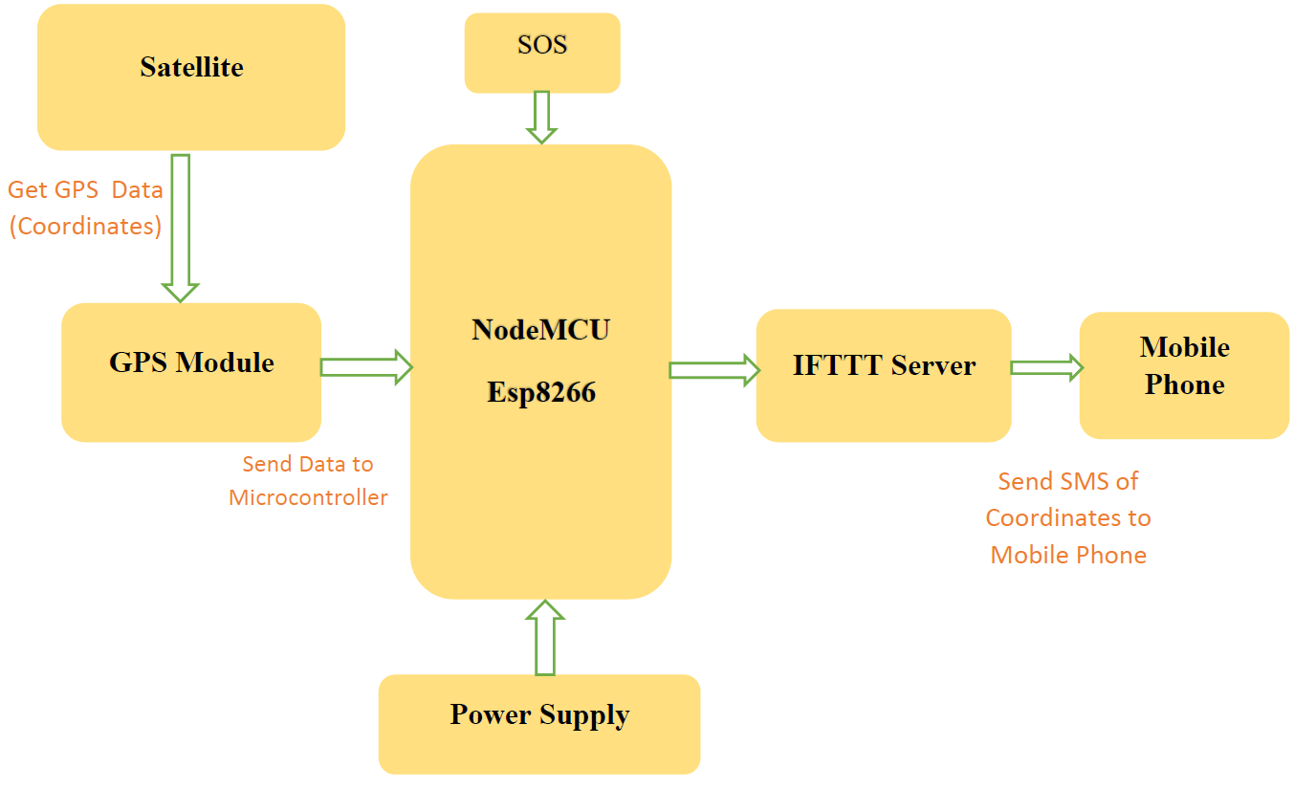
Block Diagram
Block Diagram

Slide 9

Hardware & Software Specification
Software Specification:
Arduino Software (IDE): The Arduino Integrated Development Environment (IDE) is a cross-platform application that is written in functions of C and C++.
It is used to write, compile and upload programs to the Arduino Boards and few other third party microcontrollers and modules which support the Arduino software.
Developers: Arduino Software
Software version used : Arduino 1.8.13
IFTTT (If This Than That): It is a free web-based service to create chains of simple conditional statements, called applets. An applet is triggered by changes that occur within other web services such as Gmail, Facebook, Instagram, or Pinterest.
Here we used IFTTT to use Webhook and Android message in chain. For building our project.

Slide 10
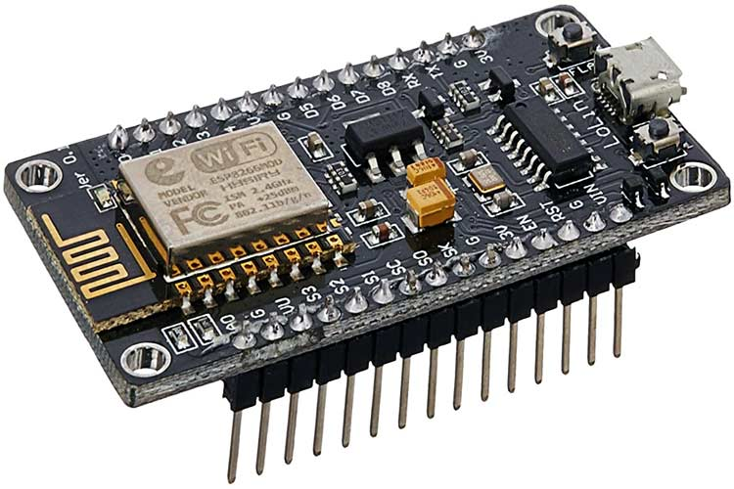
Hardware Specification:
NodeMCU esp8266: NodeMCU is an open-source Lua based firmware and development board specially targeted for IoT based Applications. It includes firmware that runs on the ESP8266 Wi-Fi SoC from Espressif Systems, and hardware which is based on the ESP-12 module.
Microcontroller: Tensilica 32-bit RISC CPU Xtensa LX106
Operating Voltage: 3.3V
Input Voltage: 5-12V
Digital I/O Pins (DIO): 16
Analog Input Pins (ADC): 1
Flash Memory: 4 MB
SRAM: 64 KB
Clock Speed: 80 MHz
USB-TTL based on CP2102 is included onboard

Slide 11
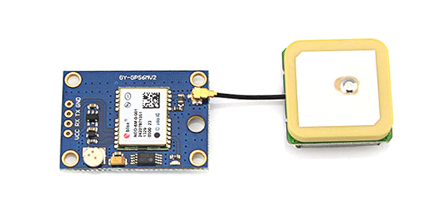
NEO-6M Receiver Module: Global Positioning System (GPS) makes use of signals sent by satellites in space and ground stations on Earth to accurately determine its position on Earth.
The NEO-6M GPS receiver module uses UART communication to communicate with the microcontroller.
It receives information like latitude, longitude, altitude, UTC time. Etc. from the satellites in the NMEA format. This need to be decoded to extract the information that we want to use.
GPS satellites transmit information signal over radio frequency (1.1 to 1.5 GHz) to the receiver.
Power supply:2.7v - 3.6V
Maximum DC current at any output: 10mA
Operation limits: Velocity-500m/s, Altitude-50000m.
Operating temperature range: -40ºC TO 85°C
Library used for config: TinyGPS

Slide 12
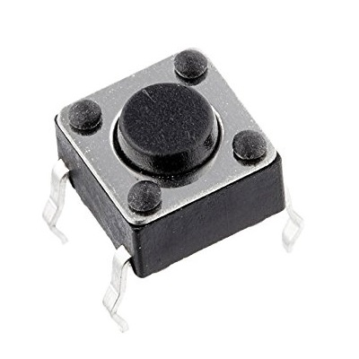
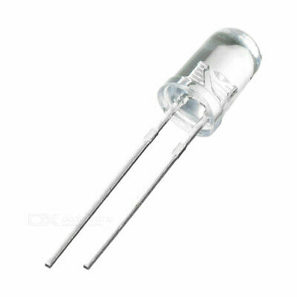
Push button/SOS button: A push button is a simple type of switch that controls an action in a machine or some type of process. Most of the time, the buttons are plastic or metal. It is used with 10k resister.
Led: A light-emitting diode (LED) is a semiconductor light source that emits light when current flows through it. Electrons in the semiconductor recombine with electron holes, releasing energy in the form of photons.
Power Source: Any battery or Power bank can be used to power on the system.
Operating voltage of the system: 5V
We are using a Power bank with output voltage of 5V

Slide 13
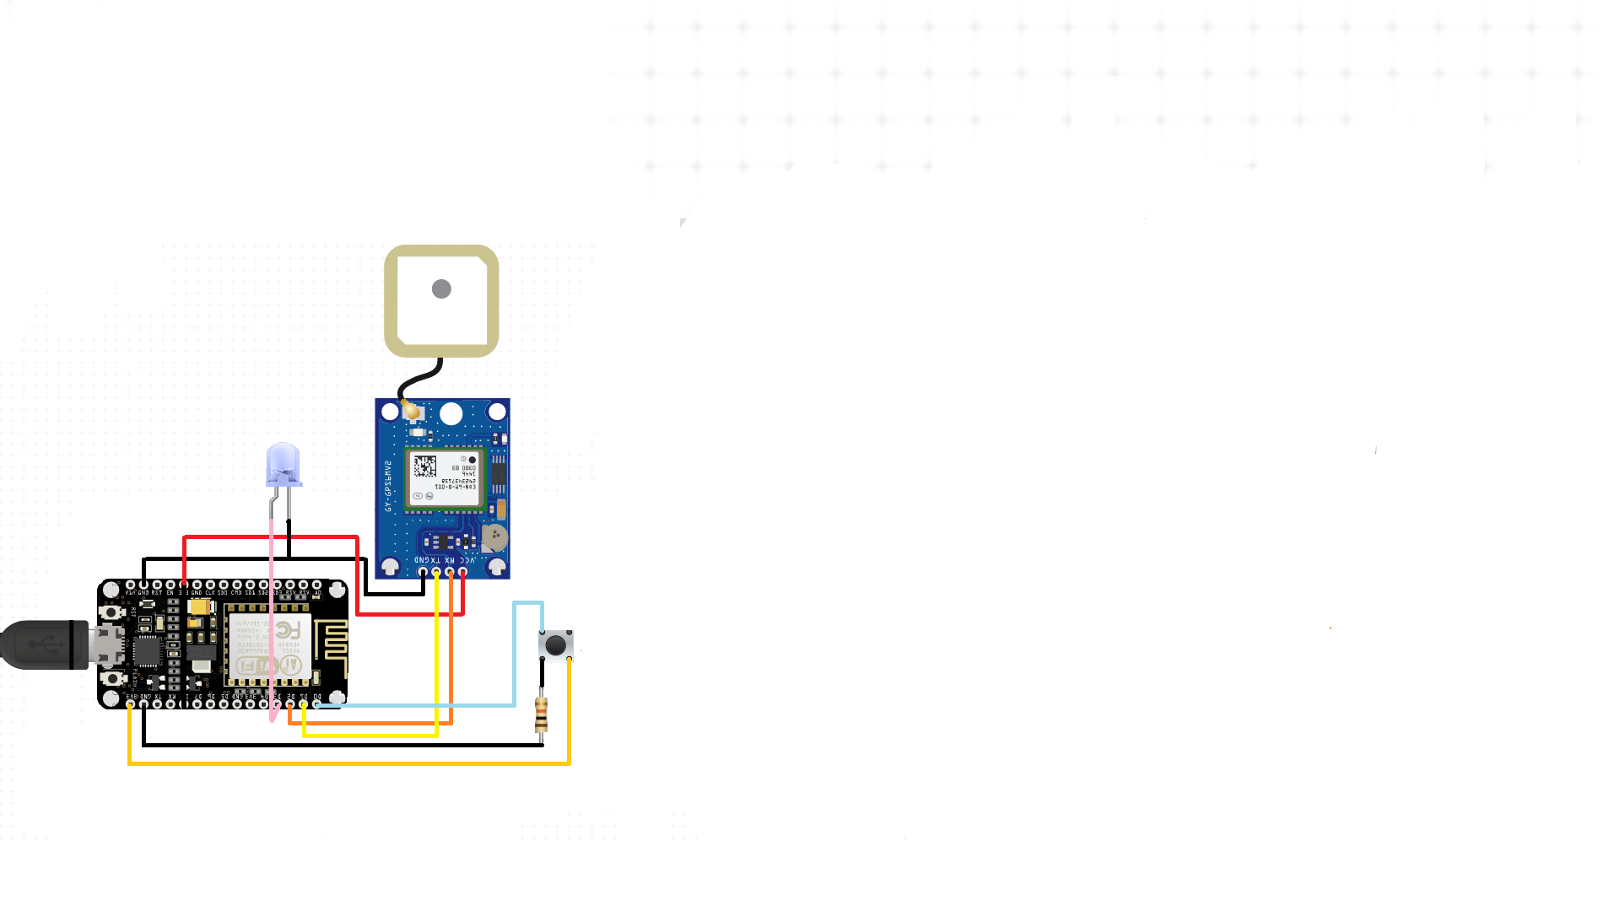
Circuit Diagram & Working
Circuit Diagram

Slide 14
Working
When the device is turned on using power source, NodeMCU will get connected to the given WIFI Network and GPS module starts receiving data in the NMEA format.
NodeMCU will decode the NMEA data to GPS Coordinates using certain libraries and display it on serial monitor.
As soon as SOS button is pressed and Hold, Led is turned on, NodeMCU will start connecting to IFTTT server and make a Webhook request, along with the GPS Coordinates.
As soon as the Webhook request is triggered from NodeMCU, Android message applet gets activated and a message is sent to the mobile number configured in the Android message applet.
It will also trigger an Emergency Notification alert on the Phone and message sent consists of the GPS Coordinates that was received from the GPS module.

Slide 15
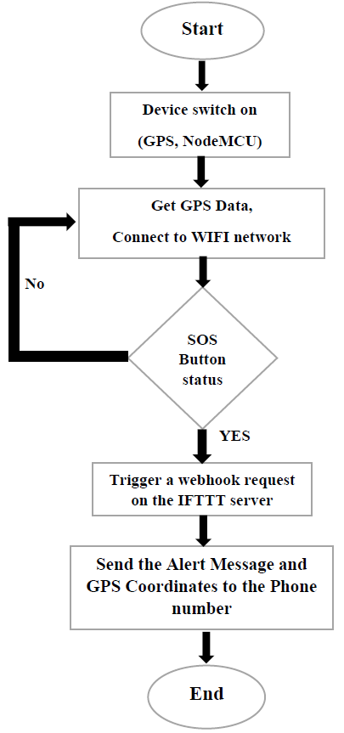
Flow Chart

Slide 16
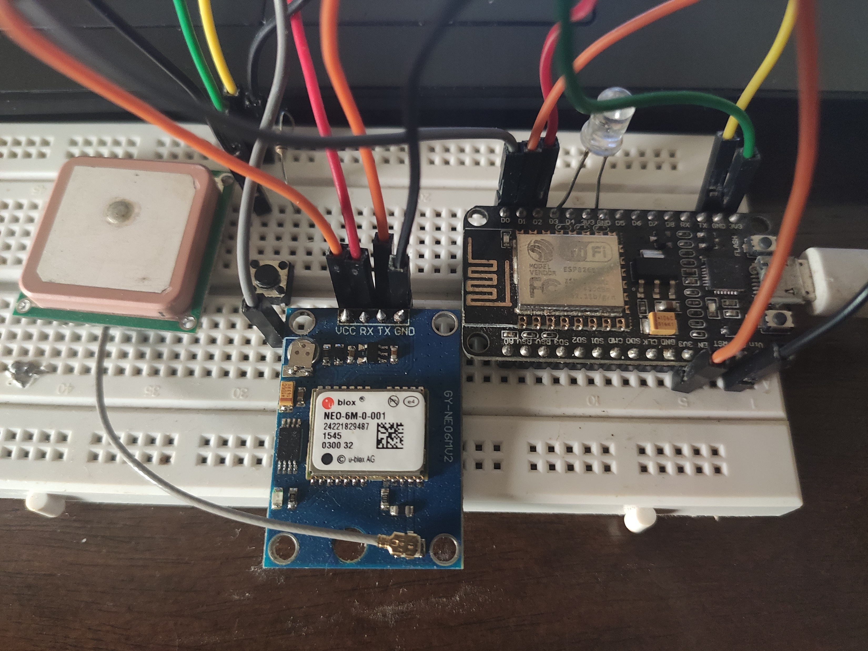
Results & Discussion
The main purpose of the work is to provide safety and security to the women in danger situation. When the SOS button is pressed by women as soon as she feels insecure than the exact location is sent to the friend with the Alert message stating
“HELP ME
I’M IN TROUBLE…!
My Coordinates are: Longitude , Latitude”
It is working as per our Objectives.
Final Circuit built

Slide 17
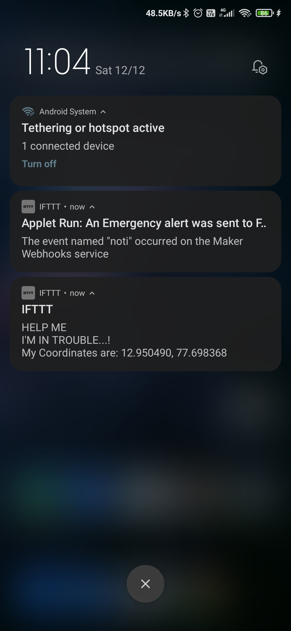
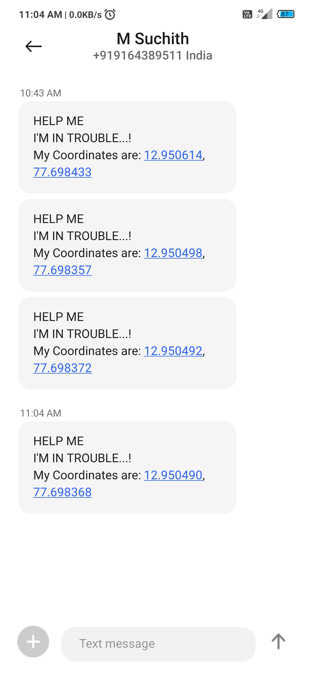
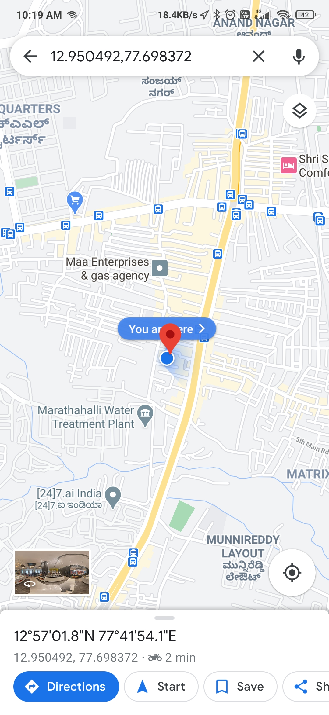

Final Output of Screenshots from Phone

Slide 18
Advantages
Advantages:
Can be used for the safety of women to easily track a woman’s location with the help of coordinates sent.
Can be used for the safety of children, elderly aged people.
Can be used for the safety of physically challenged people.
Useful in Security applications.
Since it is using online platform we can update the contact very frequently need not change the actual code of the project.
Can be used as a legal evidence of crime with exact location information for prosecution.
Affordable for everyone.

Slide 19
Conclusion & Future Scope
Conclusion:
The proposed design will help women to deal with the critical issues faced by them and therefore it will also help to reduce the crime rates against women .
By sending location it is easier to help a needy woman.
All the applications and devices that are built using new technologies may be difficult to operate for women in rural areas.
So this system can overcome the fear that scares every woman in the country about her safety and security.
Future Scope:
Voice detector can be added to give the voice command which can be priorly feeded in NodeMCU to indicate emergency /danger.
To send the alert message to the persons near to the emergency location.
Implement some kind of tools for defence like Stun gun.

Slide 20
References
[1] Nishant Bhardwaj and Nitish Aggarwal, “Design and development of ‘SURAKSHA’- a women safety device” International Journal of Information & Computation Technology. ISSN 0974-2239 Volume 4, Number 8 (2014), pp. 787-792.
[2] Trupthi Rajendrashimpi, “Tracking and security system for women using GPS and GSM” International Journal of Information & Computation Technology. Volume: 04 Issue: 07/07/2017.
[3] D G Monisha, M Monisha, G Pavitra and R Subhashini, “Women Safety device and Application-FEMME”, Indian Journal of Science and Technology. Volume 9(10) March 2016.
[4] Jatti, Anand, et al., "Design and development of an IOT based wearable device for the safety and security of women and girl children," 2016 IEEE International Conference on Recent Trends in Electronics, Information & Communication Technology (RTEICT), IEEE, 2016.
[5] Sarosh, Muhammad Yasir, et al., "Mehfoozaurat: Transforming smart phones into women safety devices against harassment“, Proceedings of the Eighth International Conference on Information and Communication Technologies and Development, ACM, 2016.

Slide 21
Progress Work
14 Sep: Mini Project topics were suited for consideration.
05 Oct: Mini project topic was finalized as Emergency alert and tracking device for women safety
10 Oct: Software Installation process was done.
18 Oct: Working on Presentation commenced.
25 Oct: Presentation for the first review is completed.
2 Nov: Compnents were gathered.
8 Nov: Gps module and nodemcu working was checked.
14 Nov: Circuit was connected as per circuit diagram.
21 Nov: Coding of nodemcu was completed.
29 Nov: IFTTT applet was created and working of circuit was checked, hardware implementation was completed.
5 Dec:Presentaion for second review was completed and started working on report.

Slide 22
Milestones/Schedule
Milestone | Baseline Date | Target Date | Achievement
PowerPoint presentation | 5/10/2020 | 29/10/2020 | Completed
Writing of Project code | 10/10/2020 | 21/11/2020 | Completed
Hardware implementation | 2/11/2020 | 29/11/2020 | Completed
Report | 5/12/2020 | 30/12/2020 | Completed

Slide 23
Thank You

